Slide 1

Over view
·Idea
·Audience
·User Scenarios
·Design
·Next work

Slide 2
What is the most popular kind of game now?
Of course the MOBA game.
What is a MOBA game?

Slide 3
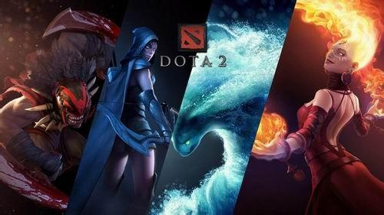


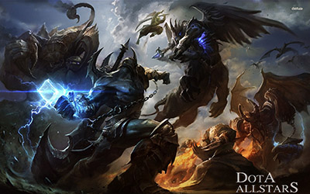
MOBA-Multiplayer Online Battle Arena Games

Slide 4
At present，League of Legends owns the largest number of Moba game。
Why:There are so many assistant software of League of Legends, why choose us？
Because：It is a new field，there is no software like Heroes Gathering.

Slide 5
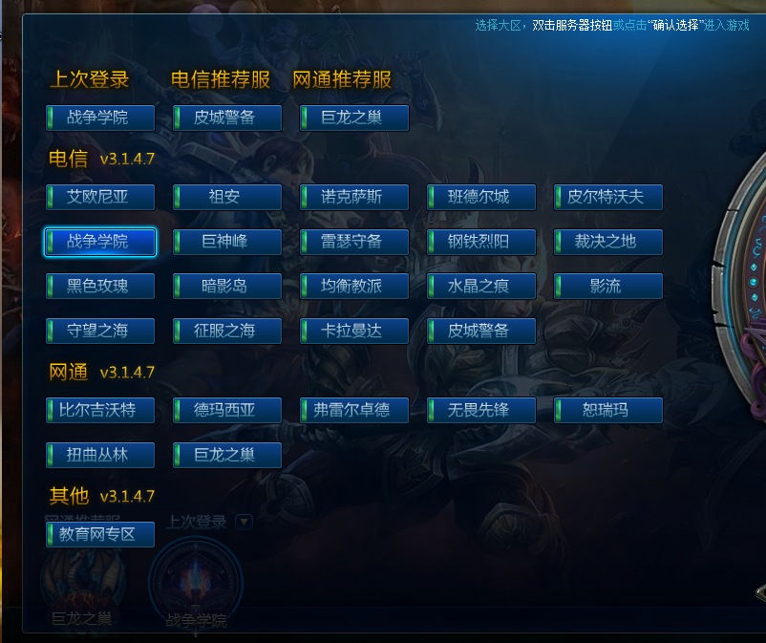
Designed
Notes:
There are 30 districts in LOL, and the account in different district doesn’t share the same profile. For example, imagine you have a very high score in the district of the War College, but if you want to play in the district of Shadow island, then you have to start over from zero, which is quite annoying.

Slide 6
We want to design an app to share LOL Account！

Slide 7
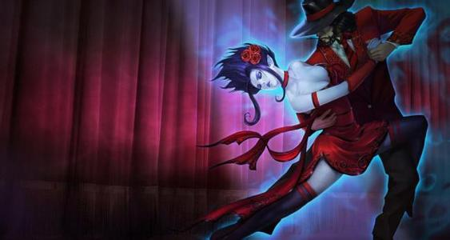
Audience
LOL player who want to use account of others‘ district.
LOL paly group
LOL players who want to share their accounts
LOL player who make living by playing games for others

Slide 8
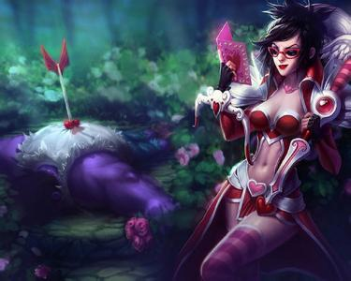
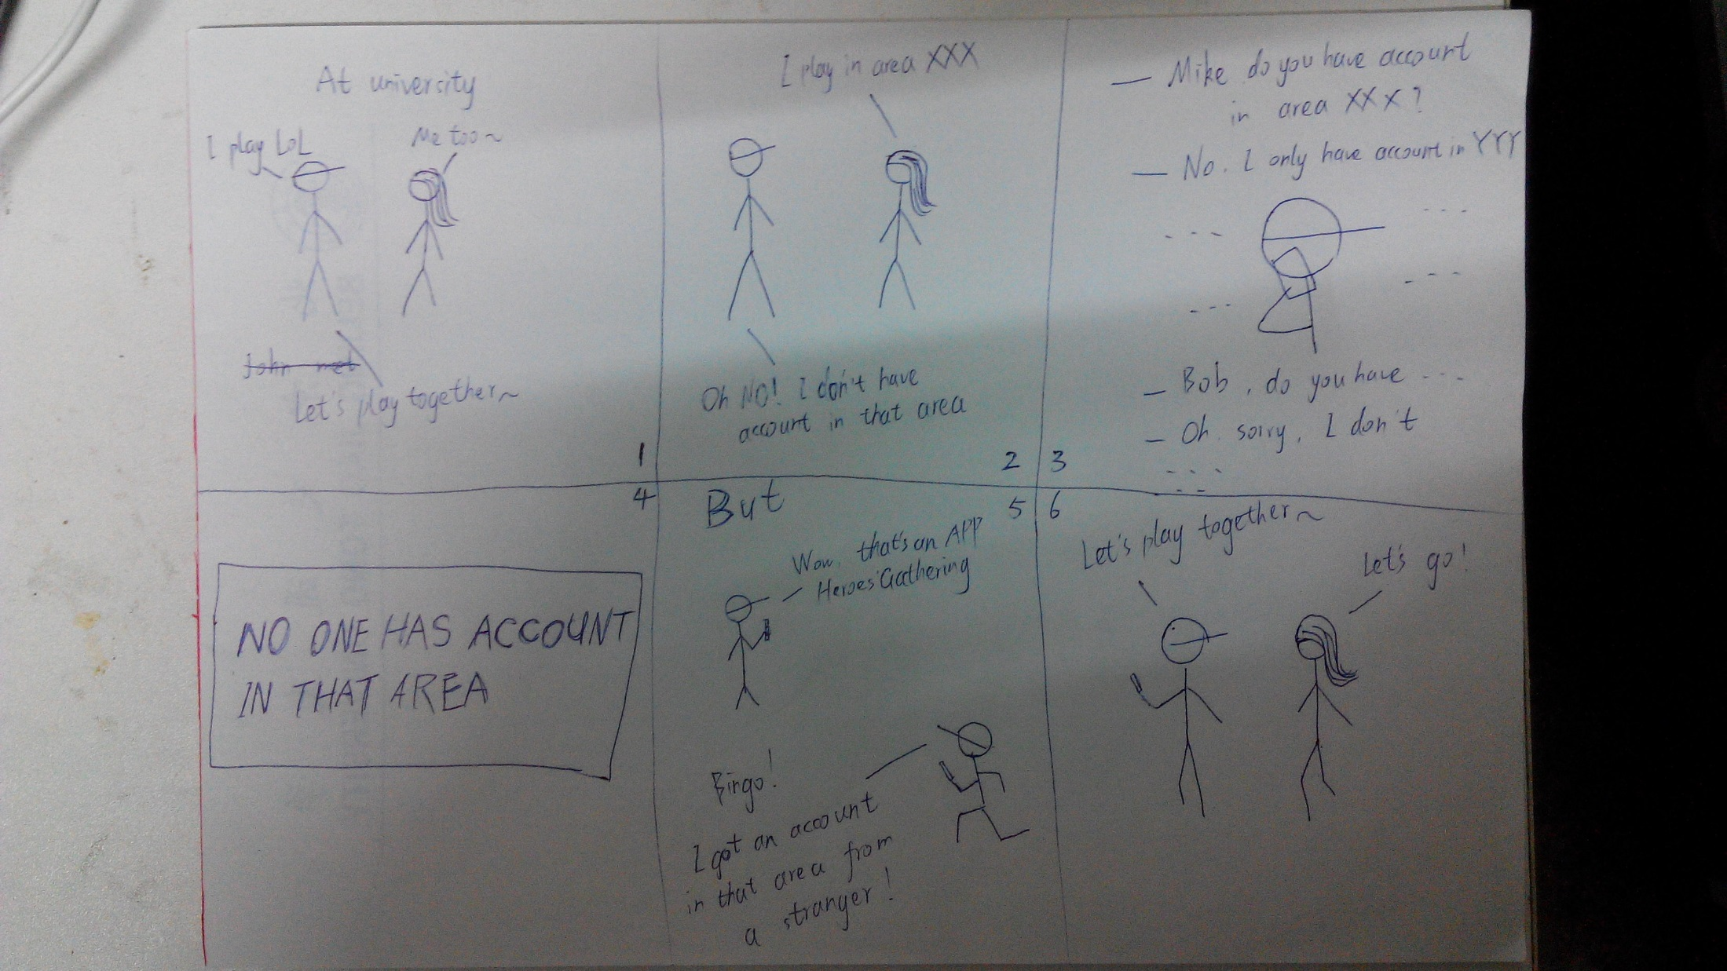
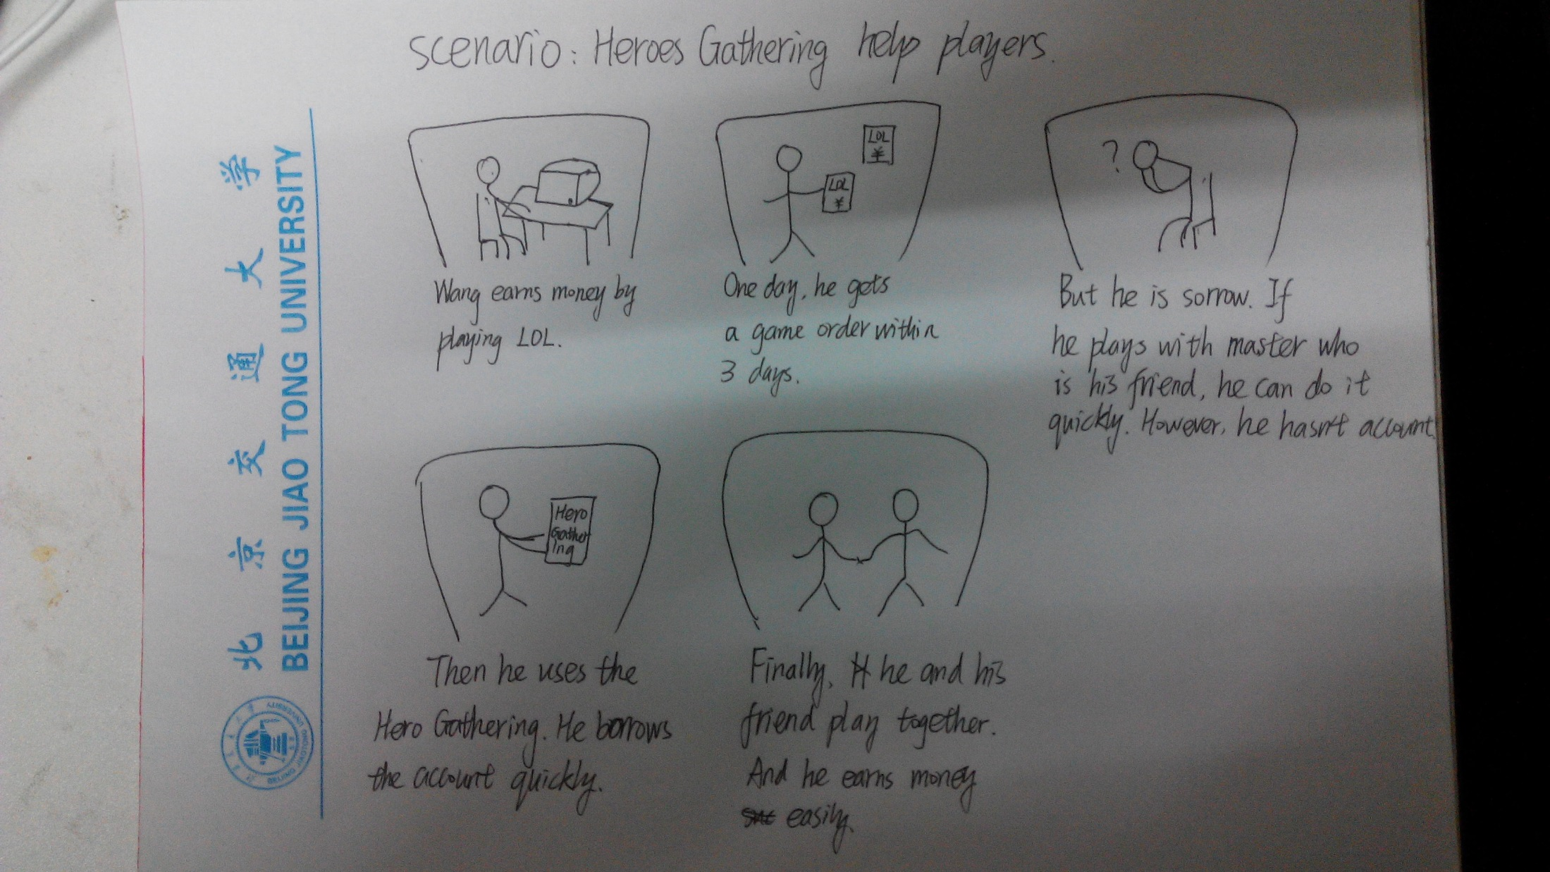
User Scenarios

Slide 9
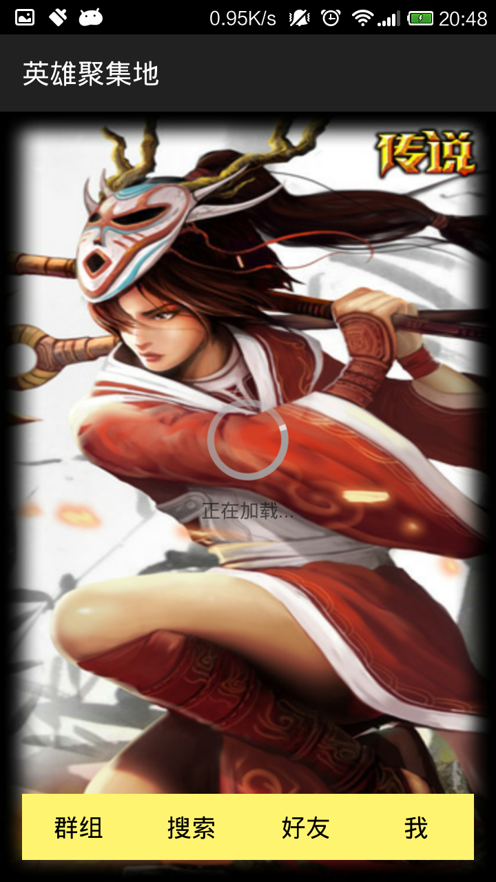
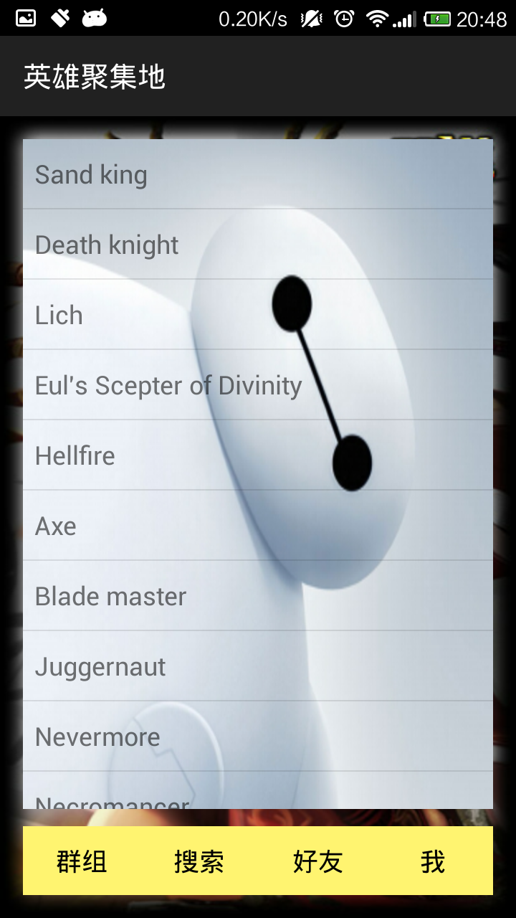
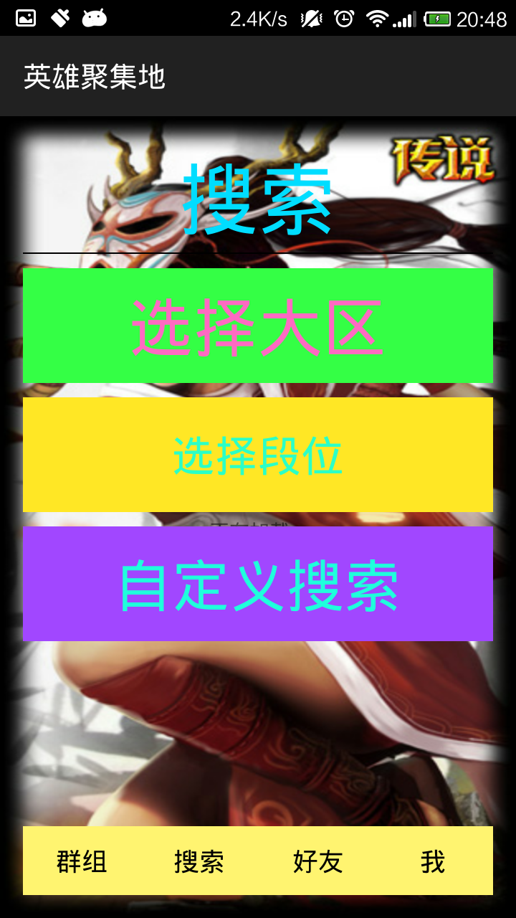
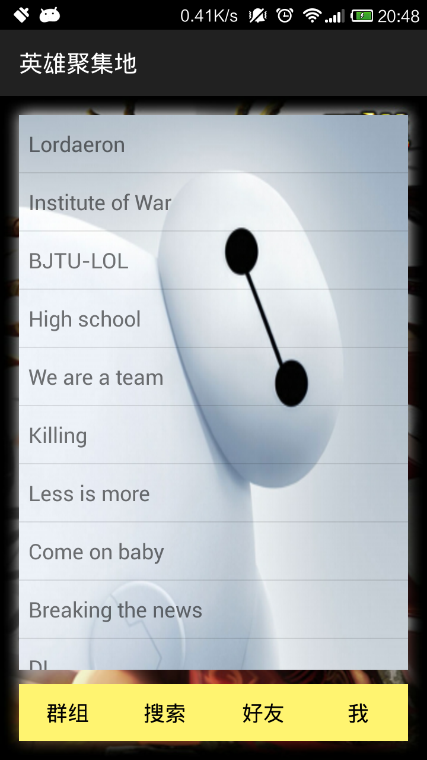
Design
Notes:
Loading screen, Friends screen, Search screen, Groups screen

Slide 10
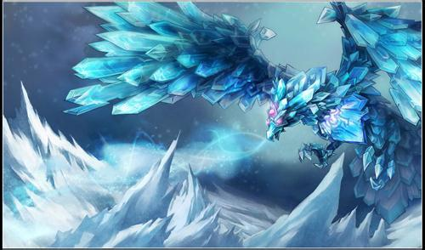
Next work
Connect our APP to the game directly.
Notes:
Run the game, and choose login with others’ account, and run our APP, choose the account you want to use, then there will be a two-dimension code shown, scan the code using the APP, and you are logged in.

Slide 11


